Slide 1
Tips for Writing Good
Résumés

Slide 2
What is a Résumé?
A résumé is a brief but detailed synopsis of your life. It includes:
heading
objective
education
work experience
school organizations
community service
honors, awards, and memberships
interests, hobbies, and talents
references

Slide 3
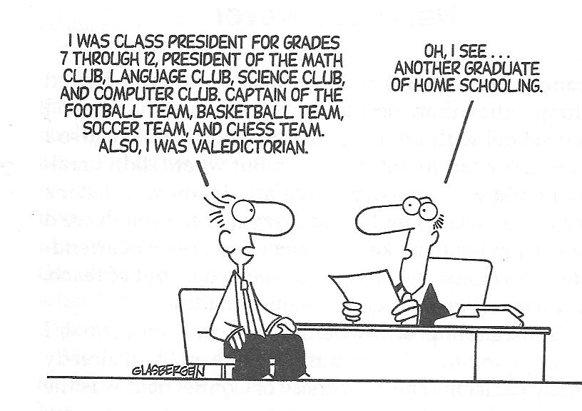

Slide 4
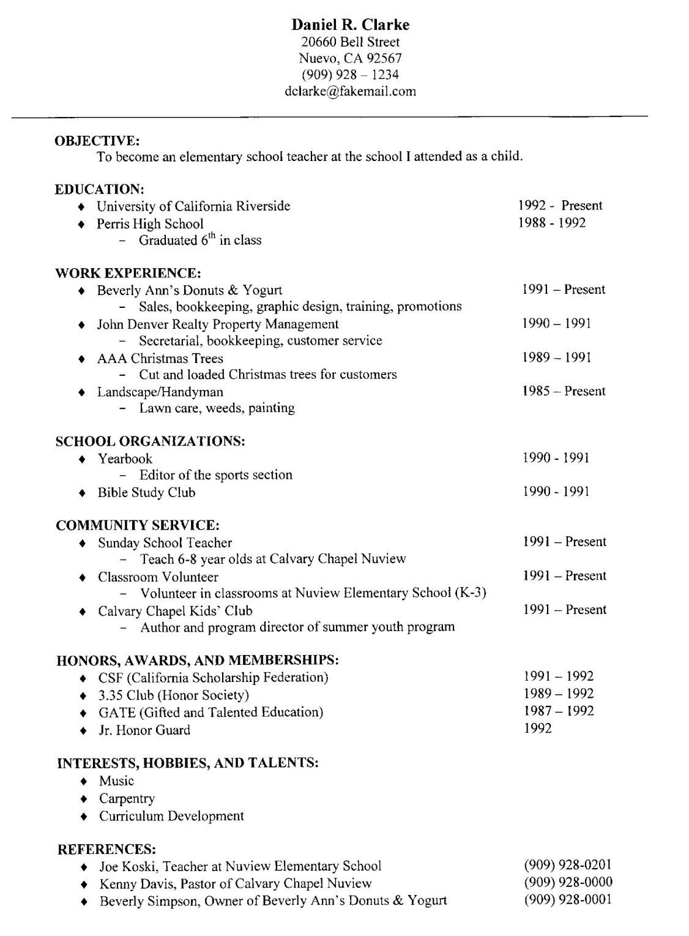

Slide 5
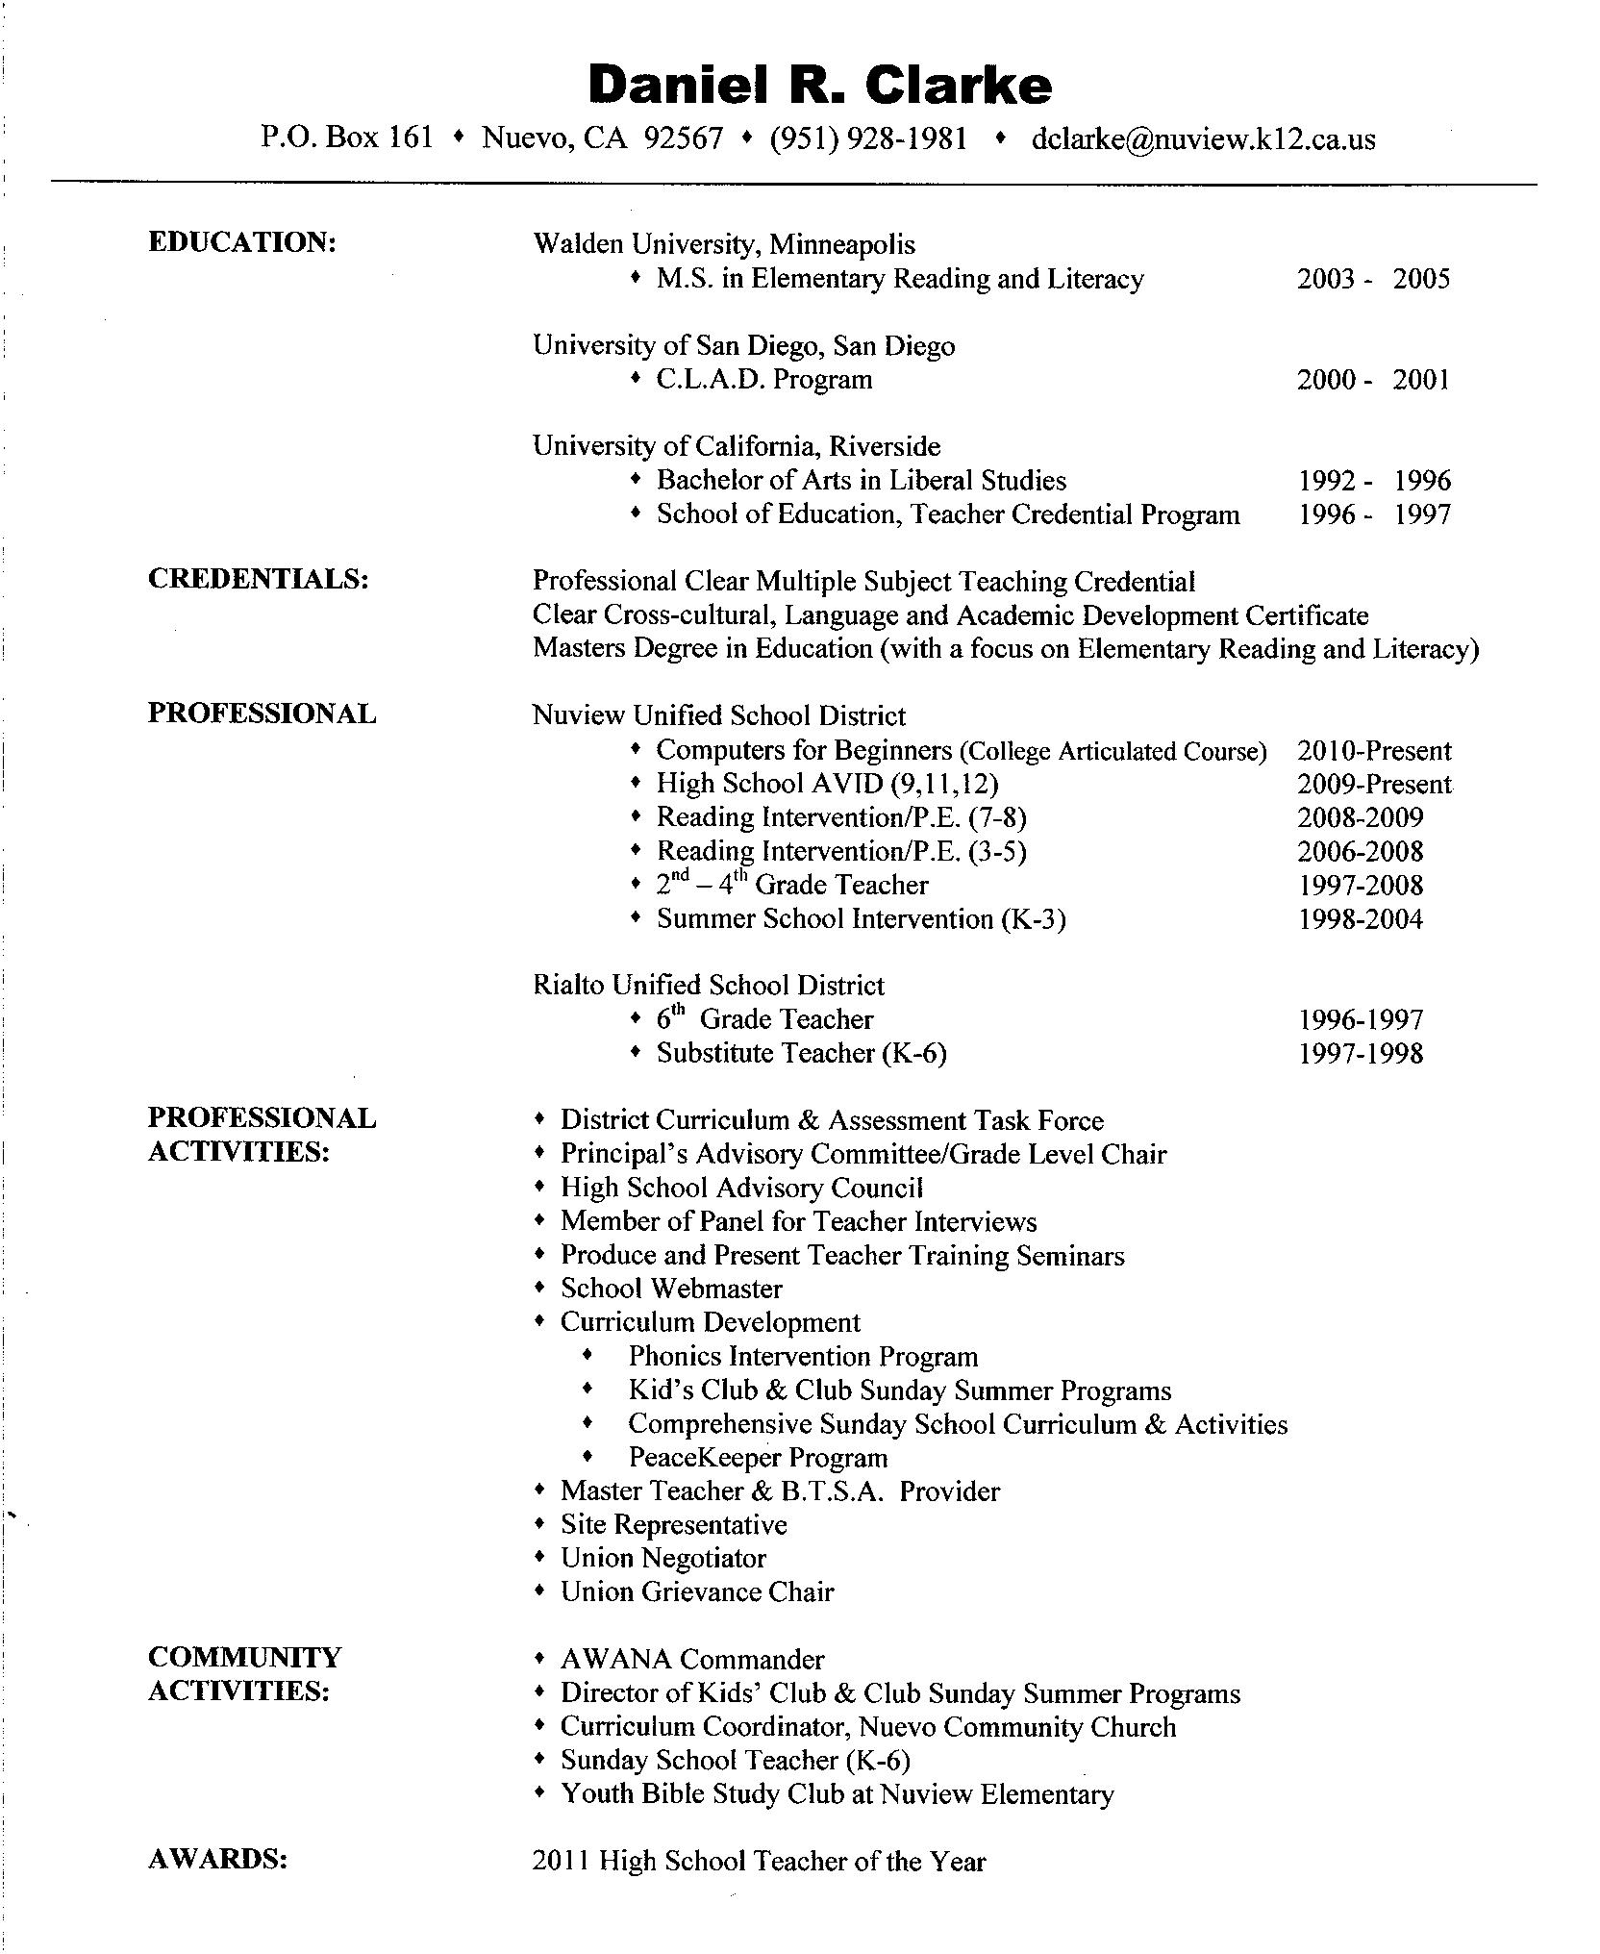

Slide 6
Heading
Center your heading at the top of the page
Name
Address
Phone number
Email address
Daniel R. Clarke
20660 Bell Street
Nuevo, CA 92567
(909) 928 – 1234
dclarke@fakemail.com

Slide 7
Objective
Your objective states your job or career goal
your resume should support your objective
OBJECTIVE:
To become an elementary school teacher at the school I attended as a child.

Slide 8
Education
List schools attended
most recent first
EDUCATION:
University of California Riverside 1992- Present
Perris High School 1989 – 1992

Slide 9
Work Experience
List jobs you have had
most recent first
WORK EXPERIENCE:
♦ Beverly Ann’s Donuts & Yogurt 1991 – Present
- Sales, bookkeeping, graphic design, training, promotions
♦ John Denver Realty Property Management 1990 – 1991
- Secretarial, bookkeeping, customer service
♦ AAA Christmas Trees 1989 – 1991
- Cut and loaded Christmas trees for customers
♦ Landscape/Handyman 1985 – Present
- Lawn care, weeds, painting

Slide 10
School Organizations
List all the school organizations or clubs you are involved in
SCHOOL ORGANIZATIONS:
♦ Yearbook 1990 - 1991
- Editor of the sports section
♦ Bible Study Club 1990 - 1991

Slide 11
Community Service
List all the community service/volunteer work you are involved in.
remember that these are unpaid activities
COMMUNITY SERVICE:
♦ Sunday School Teacher 1991 – Present
- Teach 6-8 year olds at Calvary Chapel Nuview
♦ Classroom Volunteer 1991 – Present
- Volunteer in classrooms at Nuview Elementary School (K-3)
♦ Calvary Chapel Kids’ Club 1991 – Present
- Author and program director of summer youth program

Slide 12
Honors, Awards, and Memberships
List all honors, awards, and memberships
HONORS, AWARDS, AND MEMBERSHIPS:
♦ CSF (California Scholarship Federation) 1991 – 1992
♦ 3.35 Club (Honor Society) 1989 – 1992
♦ GATE (Gifted and Talented Education) 1987 – 1992
♦ Jr. Honor Guard 1992

Slide 13
Interests, Hobbies, and Talents
List all interests, hobbies, and talents
try to include at least one of each
INTERESTS, HOBBIES, AND TALENTS:
♦ Music
♦ Carpentry
♦ Curriculum Development

Slide 14
Sports
List all sports you have been involved in
school sports
club sports
SPORTS:
♦ AYSO Soccer 1982- Present

Slide 15
References
List at least three references
choose people who know you in different ways
character
work ethic
volunteer work
academic
REFERENCES:
♦ Joe Koski, Teacher at Nuview Elementary School (909) 928-0201
♦ Kenny Davis, Pastor of Calvary Chapel Nuview (909) 928-0000
♦ Beverly Simpson, Owner of Beverly Ann’s Donuts & Yogurt (909) 928-0001

Slide 16
Résumé Tips
Must fit on one page
Keep it simple
Formats vary
List most recent information first

Slide 17
Action Words to Use on a Résumé
Accomplished
Achieved
Adopted
Adjusted
Administered
Advised
Analyzed
Assessed
Assisted
Attained
Budgeted
Calculated
Collaborated
Communicated
Completed
Conducted
Consolidated
Constructed
Consulted
Contributed
Controlled
Coordinated
Counseled
Created
Decreased
Delegated
Delivered
Demonstrated
Designed
Developed
Disseminated
Distributed
Diverted
Doubled
Eliminated
Enforced
Engineered
Equipped
Established
Evaluated
Executed
Expanded
Expedited
Generated
Implemented
Improved
Improvised
Increased
Initiated
Inspected
Inspired
Installed
Instructed
Introduced
Investigated
Launched
Maintained
Managed
Monitored
Motivated
Multiplied
Negotiated
Obtained
Opened
Operated
Ordered
Organized
Originated
Persuaded
Predicted
Prepared
Prescribed
Produced
Promoted
Proposed
Provided
Realized
Recommended
Reconciled
Reduced
Reinforced
Repaired
Revamped
Reviewed
Revised
Revitalized
Risked
Saved
Scheduled
Secured
Simplified
Sold
Solved
Strengthened
Submitted
Succeeded
Supervised
Supported
Trained
Transferred
Translated
Troubleshot
Unified
Upgraded
Utilized
Won
Wrote

